Slide 1

Twitter Data Analysis & Visualization
Under the guidance of
Dr. Prasenjit Choudhury
Asst. Professor
Presented by :
Abhishek (14/CA/638)
Department of Computer Applications
National Institute of Technology, Durgapur

Slide 2

Table Content
Introduction
Motivation
Sentimental Analysis
Approach
Demonetisation Analysis
Applications
Conclusion And Future Use

Slide 3
Introduction
Twitter.com is a popular microblogging website.
Each tweet is 140 characters in length.
Tweets are frequently used to express a tweeter’s emotion on a particular topic
There are firms which poll twitter for analysing twitter data on a particular topic
The challenge is to gather all such relevant data, detect and summarize the analysis using visualization

Slide 4
Motivation
Tweets – rich source of information.
It can lead to more accurate tools for extracting semantic information.
It provides means for empirically studying properties of social interactions.
Freely available, annotated corpus, Pre-written Classifier Codes in Python using TextBlob that can be used in NLP in order to promote research that will lead to a better understanding of how sentiment is conveyed in tweets and texts.

Slide 5
Sentimental Analysis
It is classification of the polarity of a given text in the document, sentence or phrase
The goal is to determine whether the expressed opinion in the text is positive, negative or neutral.

Slide 6
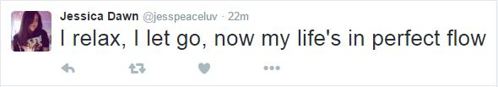

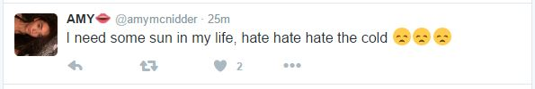
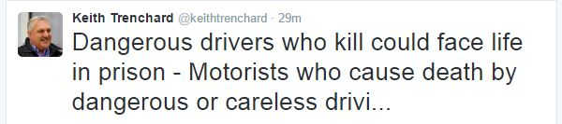
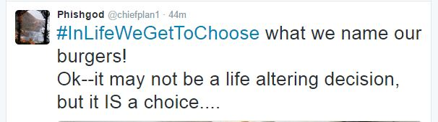

POSITIVE
NEGATIVE
NEUTRAL

Slide 7
Why is Sentimental Analysis Important
Microblogging has become popular communication tool
Opinion of the mass is important
  Political party may want to know whether people support their program or not.
  Before investing into a company, one can leverage the sentiment of the people for the company to find out where it stands.
  A company might want find out the reviews of its products

Slide 8
Problem Statement
Given a message containing a marked instance of a word or a phrase, determine whether that instance is positive, negative or neutral in that context.

Slide 9

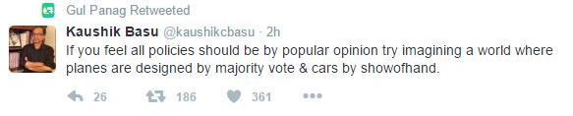
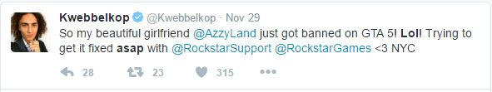
Challenges
Tweets are highly unstructured and also non-grammatical
Verbs don’t make any sense
Extensive usage of acronyms like asap, lol, afaik

Slide 10
Steps Followed
Text Input
Tokeniser
Pre-processing
TextBlob Classifier and Prediction
Tweet Extraction

Slide 11
Approach
Search tweet by a user-input keyword.
Extract tweets using Twitter API.
Tokenisation.
Pre-Processing.
  Removal of hyperlink reference.
  No retweets entertained.
Using TextBlob for awarding polarity to tweets.

Slide 12
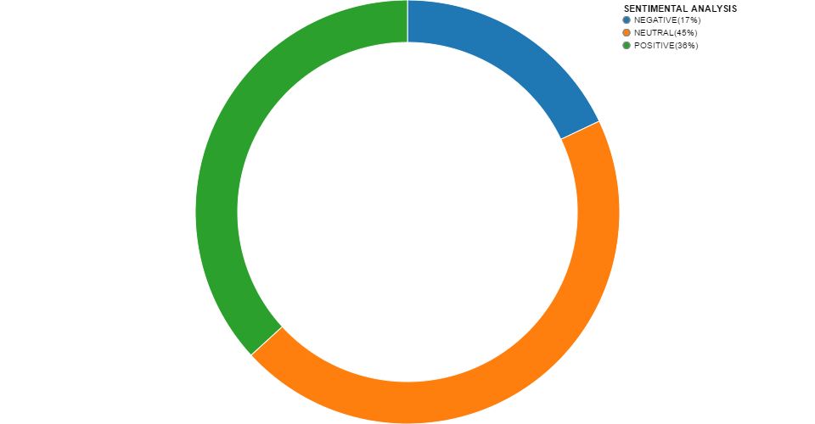
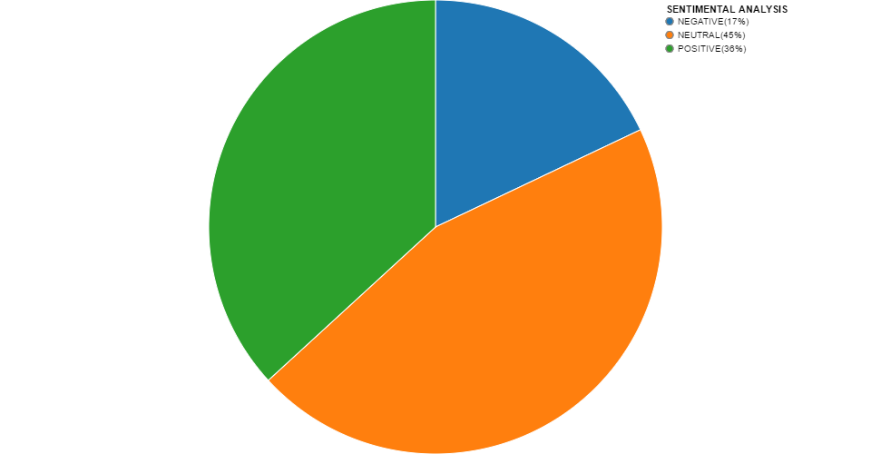
Finalizing the Result and Visualizing it
We make use of python module Vincent to show the sentiment in graphical representation.
We make use of Donut Chart and Pie Chart.

Slide 13
Demonetisation Analysis
The demonetisation of ₹500 and ₹1,000 banknotes was a policy enacted by the Government of India on 8 November 2016.
Get an overview of demonetisation effect
  What is people’s opinion about demonetisation.
  In what part of world people are discussing majorly about demonetisation.

Slide 14
Approach
Search tweet by a user-input keyword
Extract tweets using Twitter API
Tokenisation
Pre-Processing
  Removal of hyperlink reference
  Removal of verb, noun & conjunction.

Slide 15
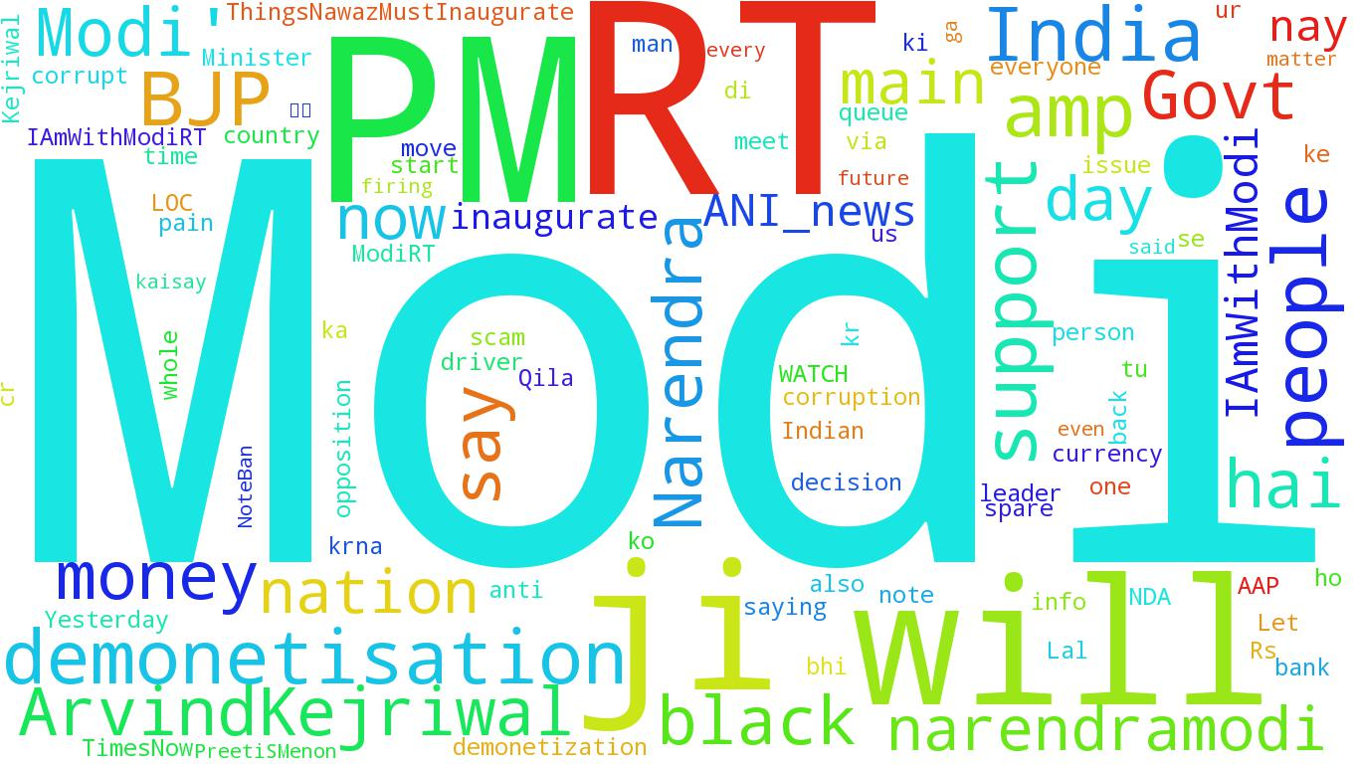
Finalizing the Result and Visualizing it
We make use of python module WordCloud to show the top 50 words people are talking about.

Slide 16
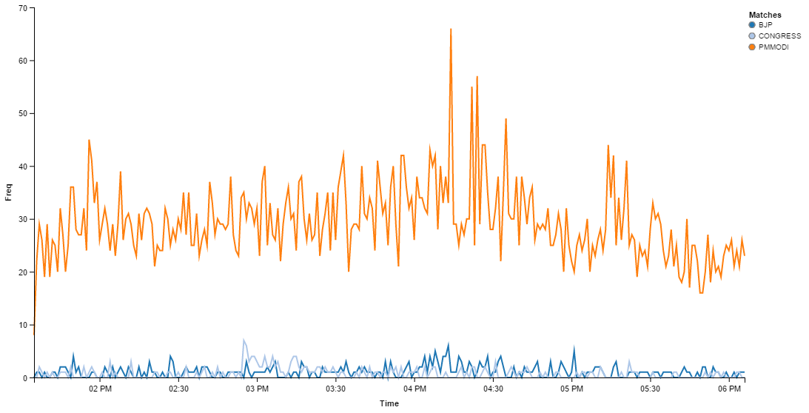
Continued..
We make use of python module Vincent to show the trendline of words BJP vs Congress vs PMModi.

Slide 17
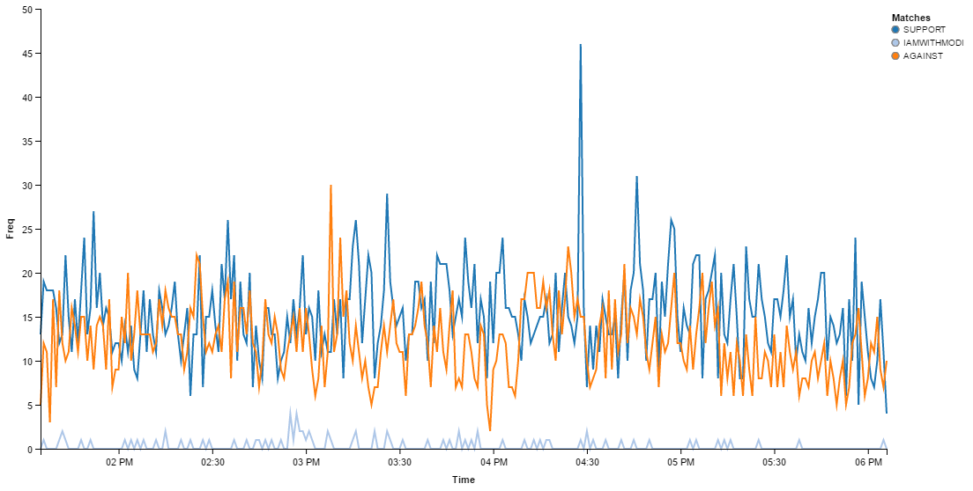
Continued..
We make use of python module Vincent to show the trendline of words Support vs Against vs IAmWithModi.

Slide 18
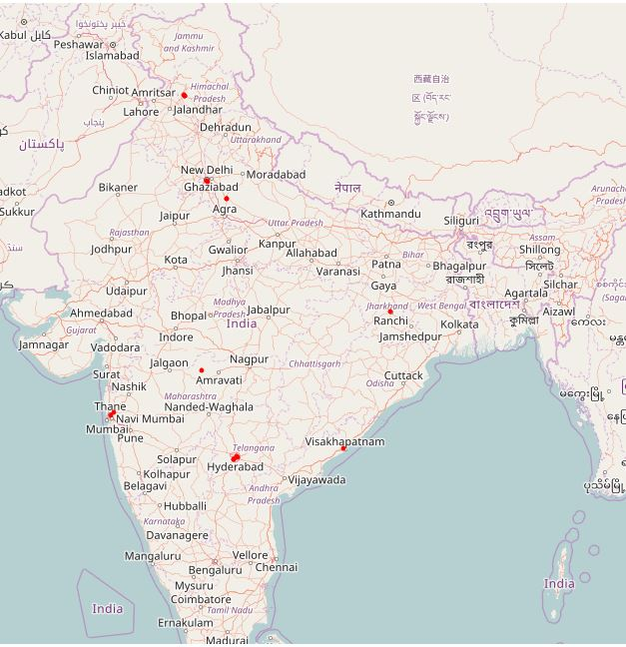
Continued..
We make use of python module Vincent to show the location of various people talking about demonetisation geographically in world map.

Slide 19
Applications
Applications to Review-Related Websites.
  Movie Review, Product Reviews etc.
Applications in Business and Government Intelligence
  Knowing Consumer attitudes and trends.
Applications across Different Domains
  Knowing public opinions for political leaders or their notions
  about rules and regulations in place etc.

Slide 20
Conclusion and Future Work
Conclusion
  We conclude that using sentimental analysis it is easier to classify tweet’s
  sentiment and give them a positive, negative or neutral polarity.
  We dig deeper into demonetisation analysis and see people talk about Modi
  the most. We visually see that more people are in favour of demonetisation
  as compared to those opposing it. If we improve the training data set more
  we can get accurate results.
Future Work
  We look forward to use bigger dataset to improve the accuracy, considering
  the emoticons and internalization.

Slide 21
#Thankyou

